Slide 1

Book Nest
Book and Reading Tracker
NAME
Zheng Mojun
DATA
03/10/2025

Slide 2






1. Introduction to the Problem Statement

Slide 3

2. Target Audience
40%
50%
10%
book lovers
casual readers
reviewers

Slide 4


3. Competitor Analysis
Bookmory
Luna Reading Tracker
It is simple and looks nice, but the layout can be messy, and genre tags are only used for statistics.
It allows reviews and ratings, but users must type in all details, and many features need payment.

Slide 5

4. Proposed Features
User Features
Add and manage books, view details like title, author, and progress.
Core Features
Track progress by chapter or page, write notes and reviews, get recommendations based on history.
UI Features
A virtual bookshelf with a grid layout, a top navigation bar, and dark/light mode.

Slide 6

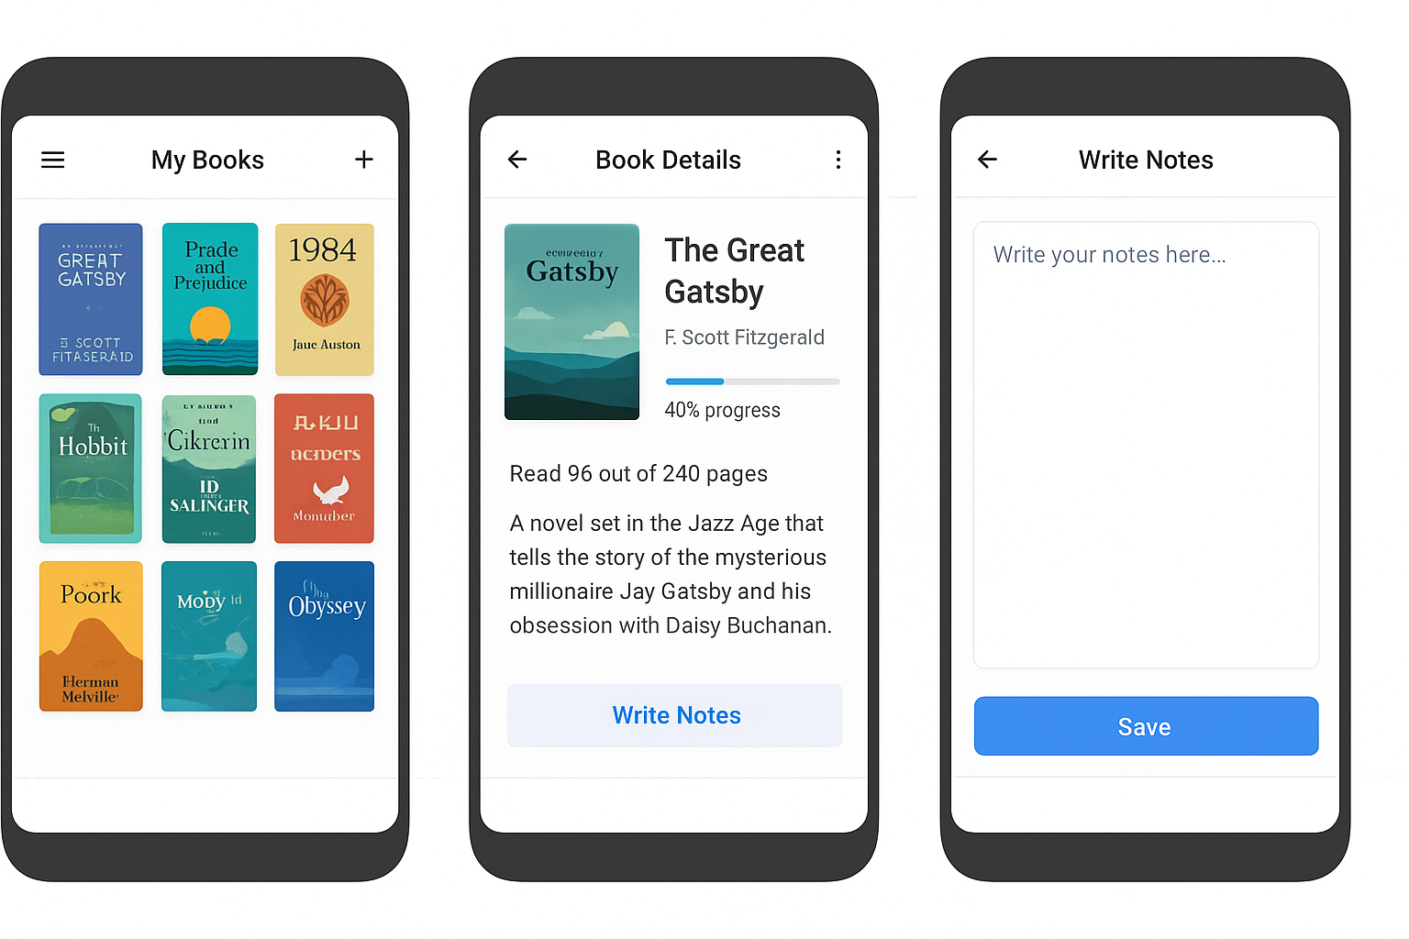
行业PPT模板http://www.1ppt.com/hangye/
5. Mockups of Screen Designs
Notes:
模板来自于： 第一PPT https://www.1ppt.com/

Slide 7

6. Timeline
Week 4–7
Week 10
Start development of the core app features, like book list and progress tracking
Final testing and submission
Week 1-3
Week 8–9
Planning document (Part A)
Code review presentation (Part B)
Testing, fixing bugs, and adding extra features

Slide 8


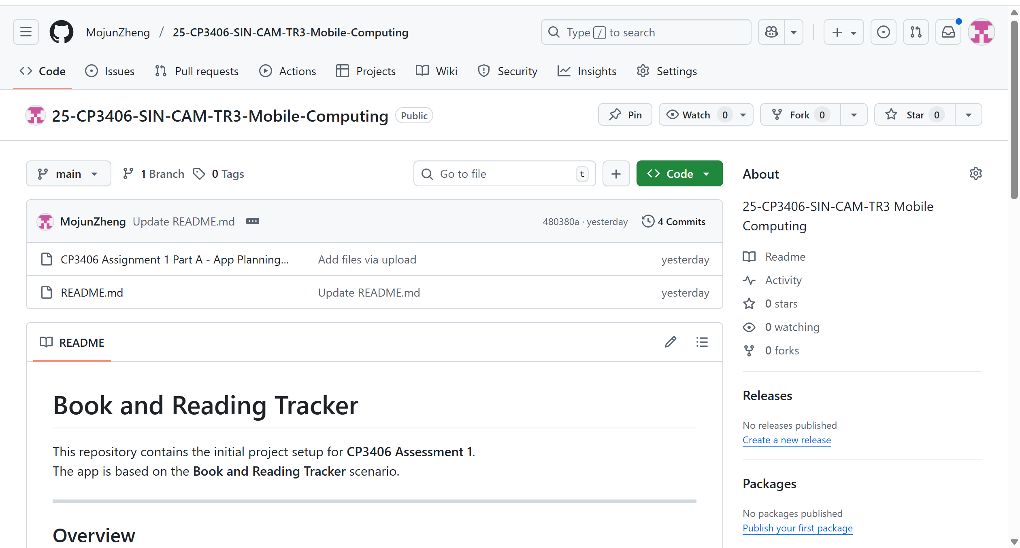
https://github.com/MojunZheng/25-CP3406-SIN-CAM-TR3-Mobile-Computing

Slide 9
Thank You！

